Slide 1

Python Heterodyne Measurement Automation
Thomas Keyes
Computer Engineering, University of Virginia

Slide 2
Program Highlights
Automatically adjusts the wavelength of lasers 3 and 4 to find the first measurement beat frequency as defined by the user
After calibrating the initial measurement state, the program determines the step size to loop from the user defined start and end beat frequency based on the input number of steps
Automatically selects the electrical spectrum analyzer for beat frequency measurements under 50 GHz
Automatically selects the wavelength meter for beat frequency measurements at or above 50GHz
Reads in data from user defined s2p files to add calibrated RF power data to the raw data
Reads in data from user defined excel sheet with beat frequency and RF loss to add calibrated RF power data to raw data
Equipment Used
Anritsu ECL Lasers 3 and 4
The program adjusts the wavelength
HP ESA 8565E/Newport Commercial PD
Program reads beat frequency < 50 GHz
HP Wavelength Meter 86120C
Program reads beat frequency >= 50 GHz
KEOPSYS Optical Amplifier (EDFA)
Program does not use
Agilent Attenuator 81577A (VOA)
Program reads P actual
Keithley Source meter 2400-C (High Power 3)
Program reads photocurrent
Rohde & Shwarz Power Meter NRP-Z58
Program reads RF power up to 110GHz frequency

Slide 3
Program Overview
Program Process
Calibrates laser 3 and 4 to a user-specified threshold of starting beat frequency
Iterates through a user-specified number of steps between start and stop beat frequency while measuring beat frequency, photocurrent, and RF power
Updates live plots of beat frequency vs. step, photocurrent vs. beat frequency, and Raw RF power vs. beat frequency during the loop
After the loop, sorts plots by beat frequency and adds a calibrated RF power vs. beat frequency plot
Prompts the user the save the data to a .txt file
User Inputs in Program
Starting wavelength for laser 3 and laser 4
Start and end beat frequency
Threshold that is acceptable within start frequency to begin
Number of steps
Delay time (s) between updating lasers and taking new measurements
Output data to .txt file (yes/no)
File name
Device number
Trial comments
Required Manual Inputs and Adjustments
Turn on all equipment
Turn on Delta WL mode on Wavelength Meter
Zero R&S Power Meter using Power Viewer Software
Enable lasers, set output power
Enable Keithley Source meter – set output voltage and current threshold
Enable optical amplifier and turn on pump
Enable VOA and adjust attenuation

Slide 4
User Input: Laser 3/4 WL, Start/Stop Frequency, Step Count, Delay, Calibration Threshold
Repeat N times (where N is the number of steps between the start and stop frequency)
Initial State:
Program Sets ECL Lasers to Start Freq
Read Beat Frequency
After N iterations
Freq >= 50 GHz (WLM)
Read RF Power
Perform Calibration
(PC, Python)
Set Wavelength (ECL)
Freq < 50 GHz (ESA)
Read Beat Frequency
Data Acquisition (PC, Python)
Waveform Plots (PC)
Channel 3 (static)
Channel 4 (dynamic)
Read I_pd and
Apply Reverse Bias Voltage
(Keithley)
.txt Output (PC)
Amplify Signal (EDFA)
Attenuate Signal (Attenuator)
Testing PD

Slide 5
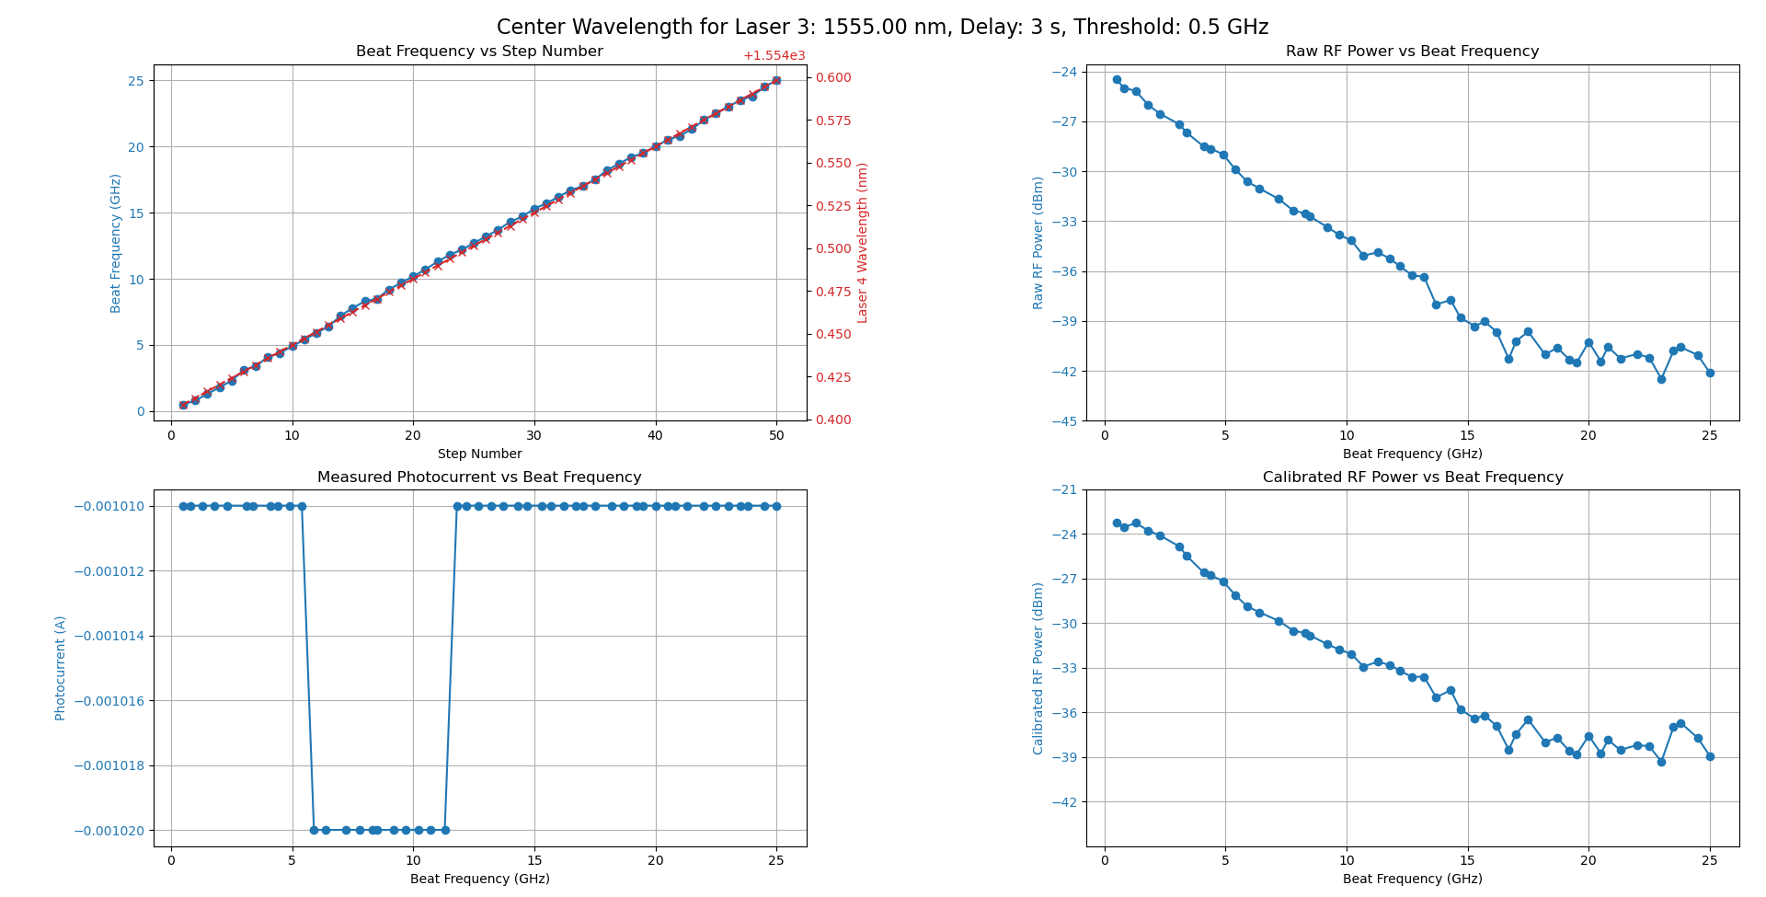
Program Output
Output Plots
The output plots contain four plots:
Beat frequency vs. step number – this is useful to see if the laser and steps and beat frequency measurements are updating reasonably
Measured photocurrent vs. beat frequency – used to visualize changes in the photocurrent reading from the Keithley
Raw RF Power vs. Beat Frequency – plots the rf power vs. beat frequency live as the measurement loop runs
Calibrated RF Power vs. Beat Frequency – once the measurement loop is finished the raw RF data is combined with the calibrated RF loss and re-plotted
*The red, right-side y-axis of the beat frequency vs. step number shows the wavelength at which laser 4 was set, as erratic points often occur in similar areas of wavelength. To get the value, add the value of the y-axis to the value at the top

Slide 6
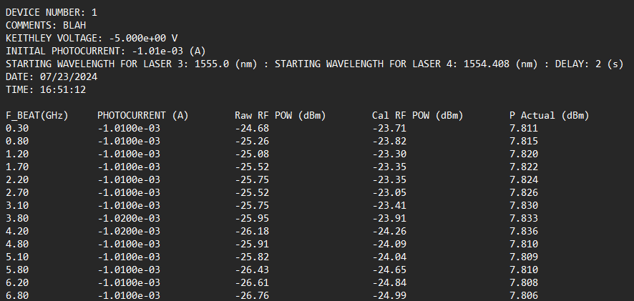
Program Output
.txt Output Data
The .txt output data contains the measured data and a mix of user defined and automatically recorded information in the header:
File name is defined by the user
Device number and trial comments are defined by the user
Keithley voltage and initial photocurrent automatically queried from the instrument
Starting wavelength for laser 3 and 4 recorded after calibrating the first measurement beat frequency, initial user defined delay is added
Time and date automatically added
Data is sorted with the corresponding beat frequency and output in a structured text file format
*The starting wavelength for laser 3 and 4 indicate what wavelength the lasers were set to once the calibration finished and before beginning the measurement loop

Slide 7
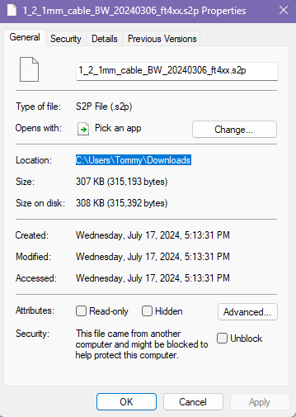
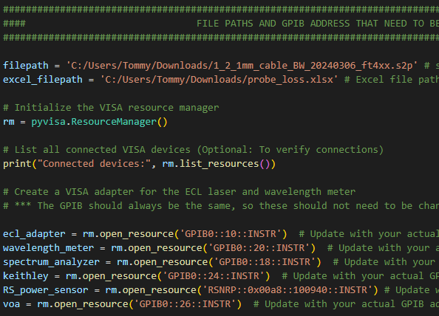
Prior to Running the Program
File Pathing and GPIB Addresses
To correctly calculate the Calibrated RF power, the file paths must be updated within the code as shown in image 1
This is located at the beginning of the code
For RF probe loss, the program automatically reads in data from an s2p file
For RF link loss, the program reads in an excel file
The excel file must contain no headers, column 1 must be frequencies and column 2 must be link loss in dB
These file paths can be found by right clicking the file, selecting properties, and copying the location, as shown in image 2
When pasting a file path for the s2p and xlsx files, a backslash is used (i.e. C:\Users\...). These must be changed manually to a forward slash (i.e. C:/Users/…)
All GPIB addresses must be correctly labeled for the instruments – these should never change but safe to check
This is located at the beginning of the code
Output from “Connected Devices” or NI Max connected devices to view GPIB addresses
Image 1 – Code File Path
Image 2 – Copy File Location

Slide 8
Prior to Running the Program
Additional Requirements if First Time Use on Personal Laptop
Python Library, Driver, Software Installation
pip install pymeasure pyvisa matplotlib scikit-rf numpy pandas openpyxl scipy (enter this command into python terminal)
Install NRP Toolkit
Install VISA Library Passport for NRP (To connect with R&S NRP-Z58 power meter)
Install NI Max (To view what devices are connected to GPIB addresses)
Install R&S Power Viewer (To zero the power meter prior to turning on other equipment)
* Installation links can be found in the “requirements” file in the github repository

Slide 9


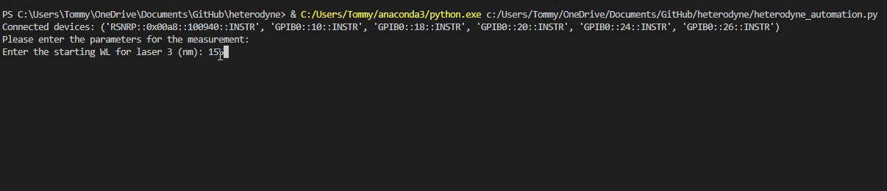
How to Get To and Run Program
Accessing and Running the Program on the Desktop
Open the software Visual Studio Code
Within Visual Studio Code find the directory named “Thomas”
Open the file named “heterodyne_automation.py”
Run the program by selecting the triangle button in the top right of the software
Enter the inputs into the command terminal as shown below

Slide 10


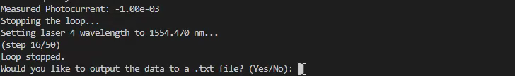
How to Get To and Run Program (cont.)
Accessing and Running the Program on the Desktop
Once the measurement loop begins, a new window will pop up, containing the plots. Click on the window, at first it may take a few second for the window to load. The icon is shown to the right
To stop the loop during the measurement, go back to the terminal and type any keystroke into the keyboard, the loop will automatically end
To save the plots, again click the window with the disk icon. In the top left of the window, click on the icon shown on the right to save the plots
After closing the plots window, the user will be prompted if they want to output the data to a text file. If yes, the user will then be prompted for the file name, device number, and trial comments

Slide 11
Using the Program
Steps of Use
Ensure setup is correct (cables, Bias-T, chip, etc)
Turn on all equipment, zero R&S Power Meter using Power Viewer software
Turn on Delta WL mode on Wavelength Meter
Enable lasers, set output power
Turn VOA Power on, do not enable (ensure α is set to 33)
Turn EDFA power switch and key to ON
Set Keithley voltage and current compliance, enable
Ensure correct bias is applied
Turn on EDFA pump (lasers must be enabled first)
Enable the VOA, read the photocurrent on Keithley and adjust α until reaching the desired photocurrent
Run the program and enter user inputs into terminal
While the program is running, it can be cancelled at any time using (ctrl + c) on the keyboard; no data saved
To exit loop early, select terminal and type any keystroke on keyboard, loop will exit and data will be saved
At conclusion of the program, the plots will stay open and can be saved or closed
Once the plots figure has been closed, the user will be prompted as to output the data or not
Common Errors
VISA Address not found
Ensure the GPIB hub is connected (blue USB connector) as well as the R&S power sensor is connected by USB (black USB connector)
Try the program again
Calibration overstepped the threshold
Try the program again with different starting wavelength inputs
Error reading network analyzer/excel file
Ensure the correct file path are input for the .s2p and .xlsx loss data
Access Code and Related Files
https://github.com/axx2xu/heterodyne

Slide 12
Suggested Settings
Wavelength and Delay Inputs
Over trials that have been run, center wavelength of 1555nm (laser 3 set to 1555nm and laser 4 calibrated to match) generally has best results
When lasers 3 and 4 are set near 1555nm, the wavelength meter typically reads near 1550nm, which indicates the lasers are ~ 5nm in wavelength lower than what they are set to
Laser 4 has an actual wavelength of ~ 1nm below that of laser 3, advised to set laser 3 wavelength 1-2nm below laser 4 for initial trials to avoid accidentally overstepping the calibration loop
User-input delay between updating lasers and remeasuring of over 2 seconds typically offers best results
Previous beat frequency vs. step plots are shown on following slides and highlight typical areas of issue, notably:
Common issues when laser 4 is set between 1544.1 – 1544.5nm
Common issues when laser 4 is set between 1549.5-1549.9 nm
Common issues when laser 4 is set between 1554.9-1555.2 nm

Slide 13
Beat Frequency vs. Step Graphing for Different Center Wavelengths
Center wavelength 1545nm: Inconsistency for all delay periods, less inconsistency with longer delay. Common issues when laser 4 is set between 1544.1 – 1544.5nm
Center wavelength 1550nm: Inconsistency for all delay periods, less inconsistency with longer delay. Common issues when laser 4 is set between 1549.5-1549.9 nm
Center wavelength 1555nm: Inconsistency for all delay periods, longer delay may have less consistency but were still inconsistent. Common issues when laser 4 is set between 1554.9-1555.2 nm
Conclusion
Of the three tested center wavelengths, 1555nm appears to be the most consistent. Results may differ significantly between periods where the instruments have been turned off. Consecutive measurements may also be inconsistent with little delay between them. The measurements seem to be more accurate as the instruments have been on for longer periods of time. Recommend to test different center wavelengths and delays to find what is most accurate at the time before taking notable measurement recordings.

Slide 14
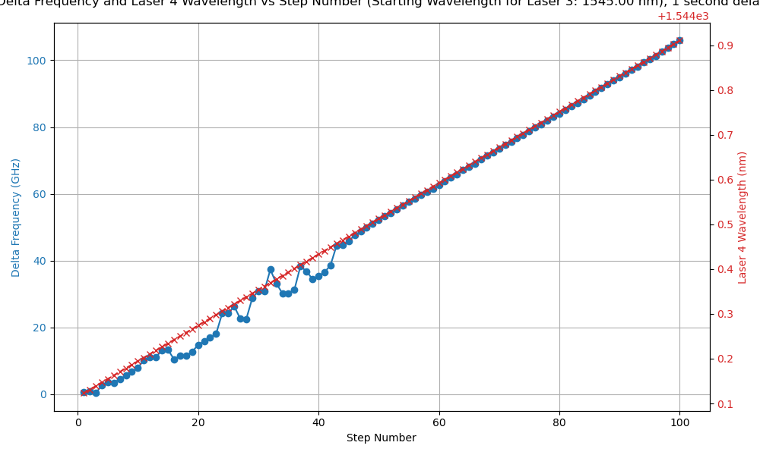
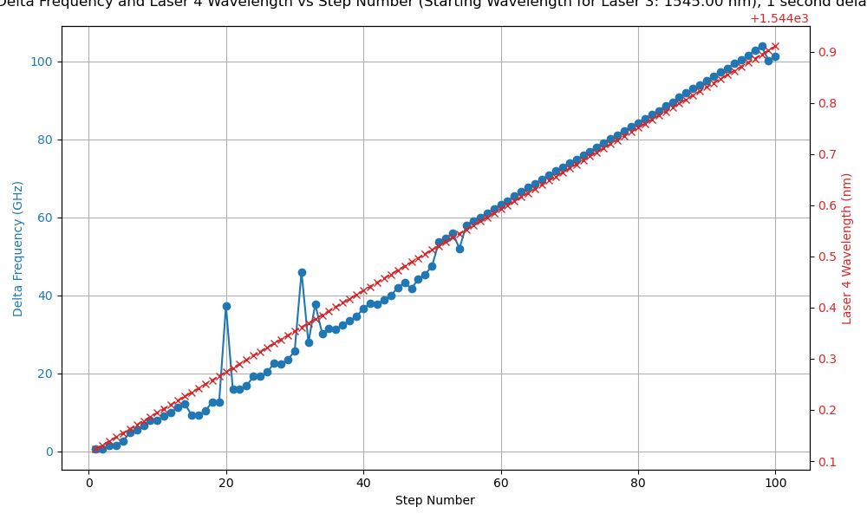
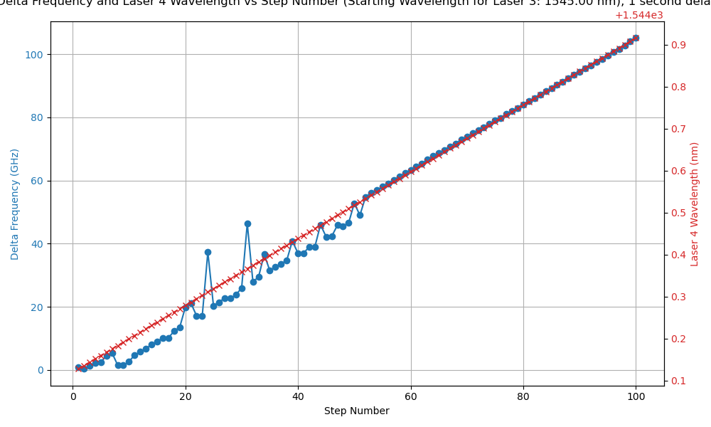
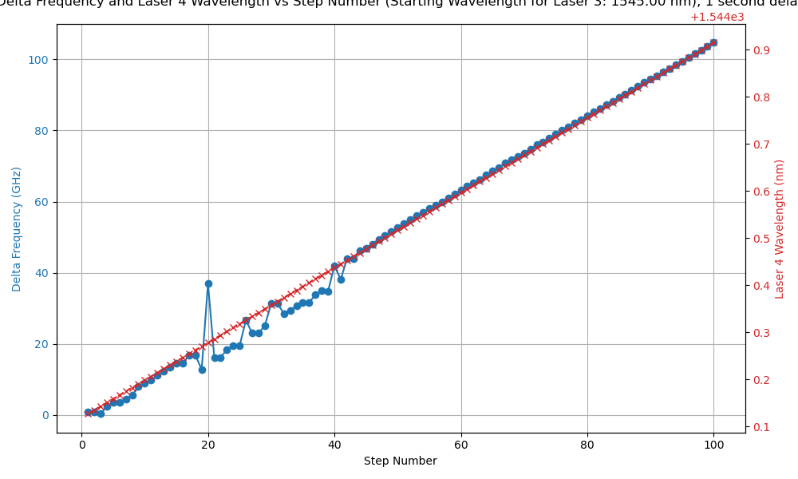
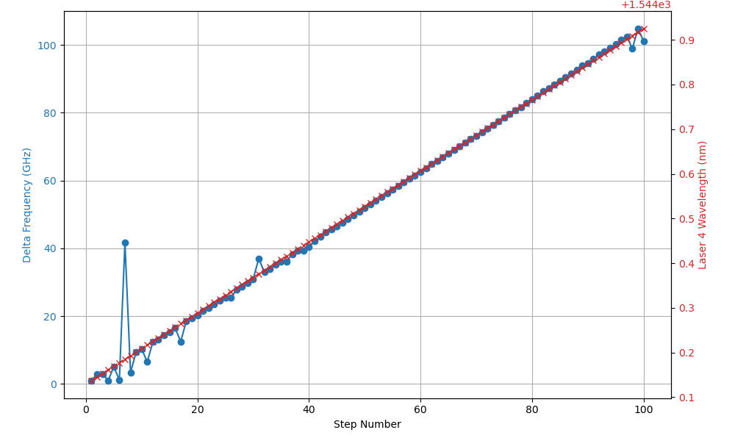
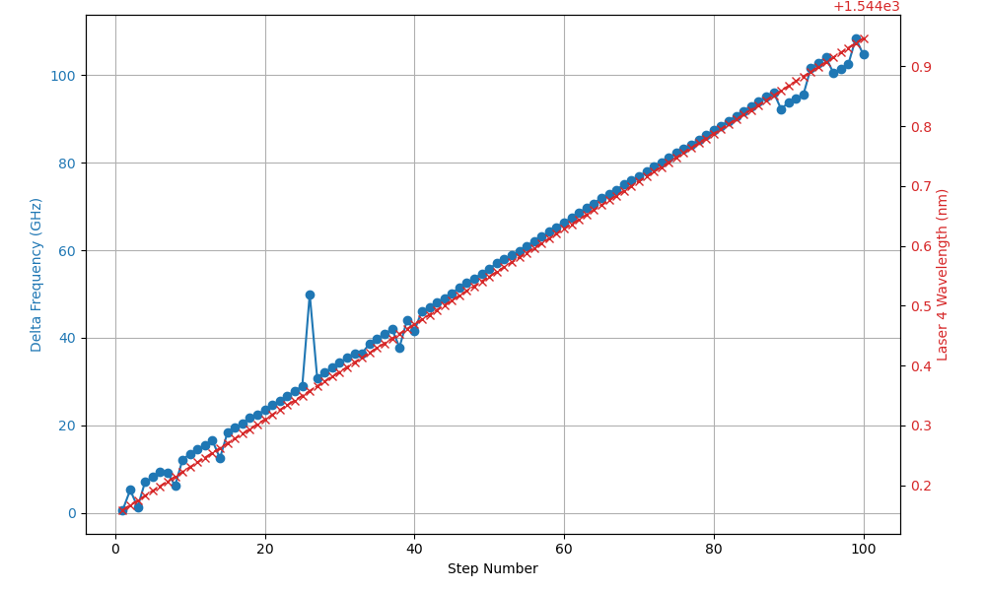
Beat Frequency vs. Step Graphing – 1545 nm
1s Delay
1.5s Delay
2s Delay
Issues common when laser 4 is set between 1544.1 – 1544.5nm

Slide 15
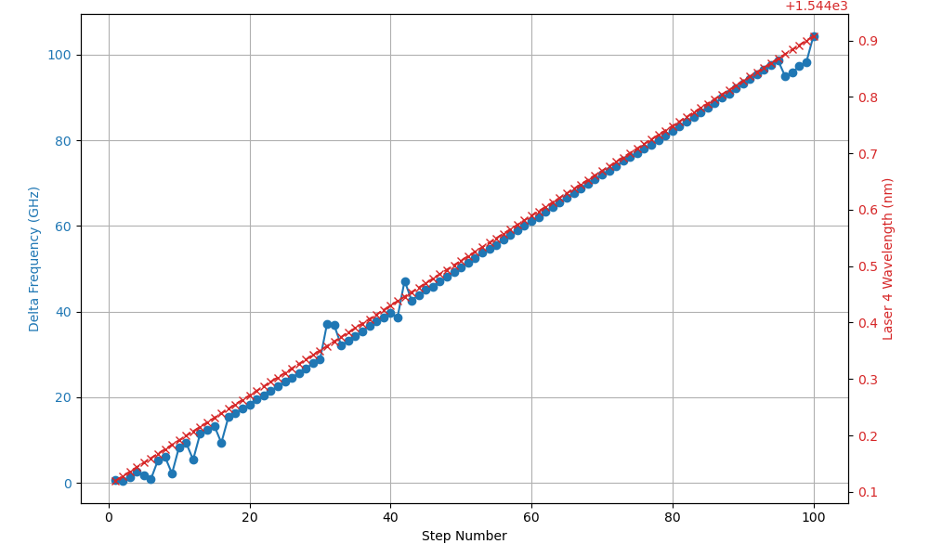
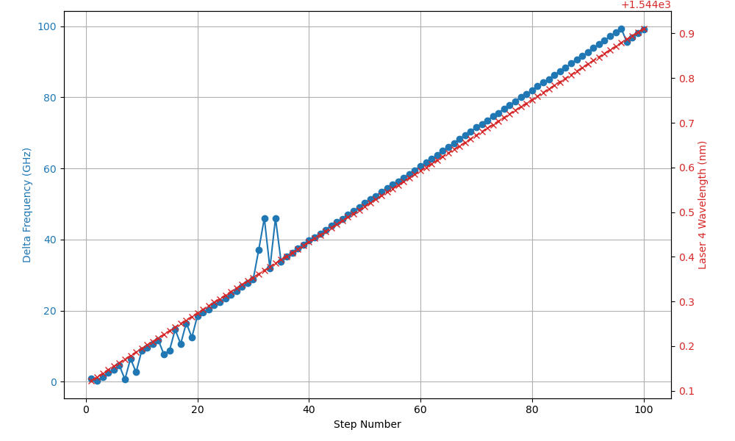
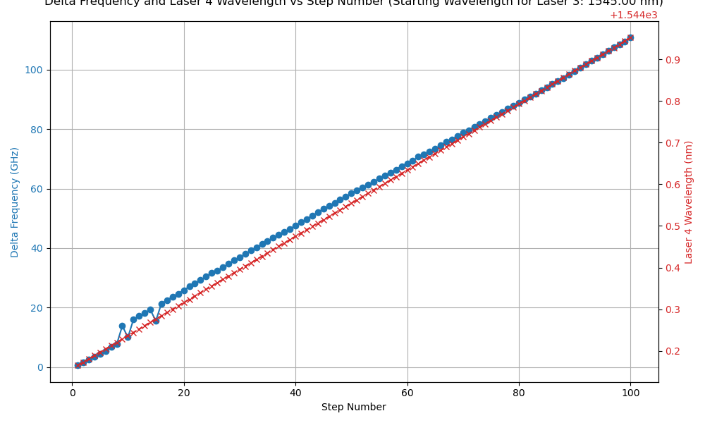
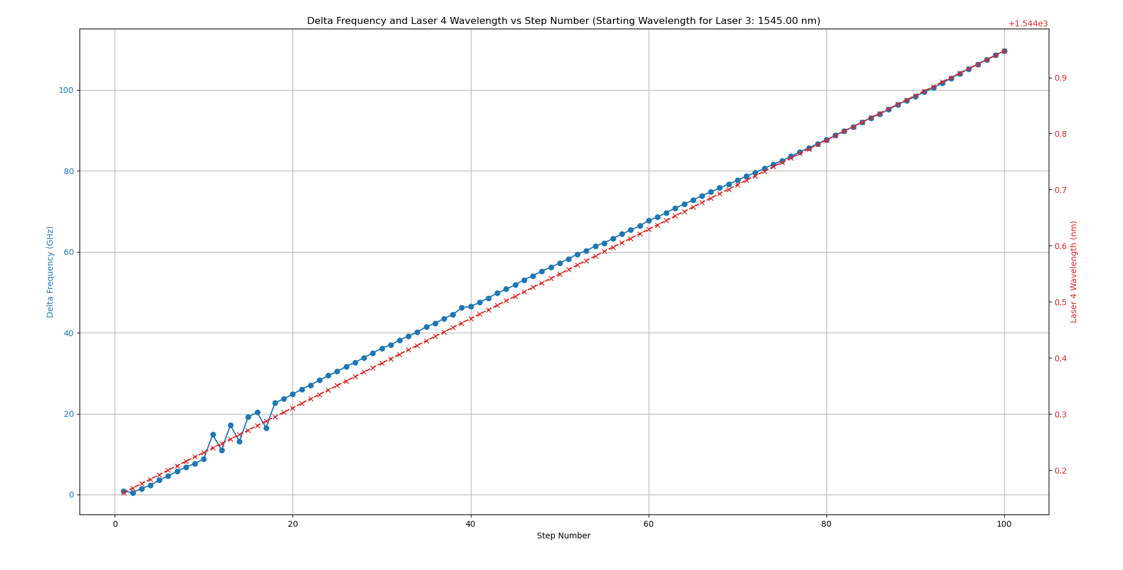
Beat Frequency vs. Step Graphing – 1545 nm
3s Delay
4s Delay

Slide 16
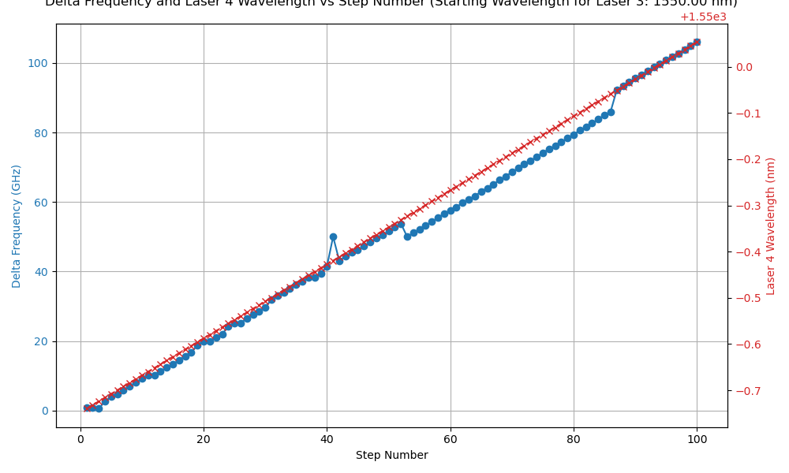
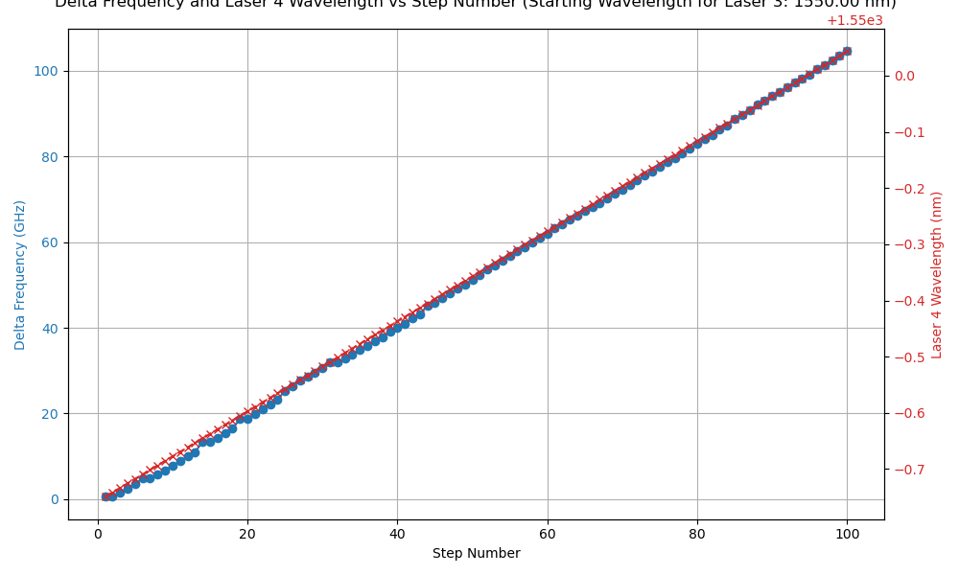
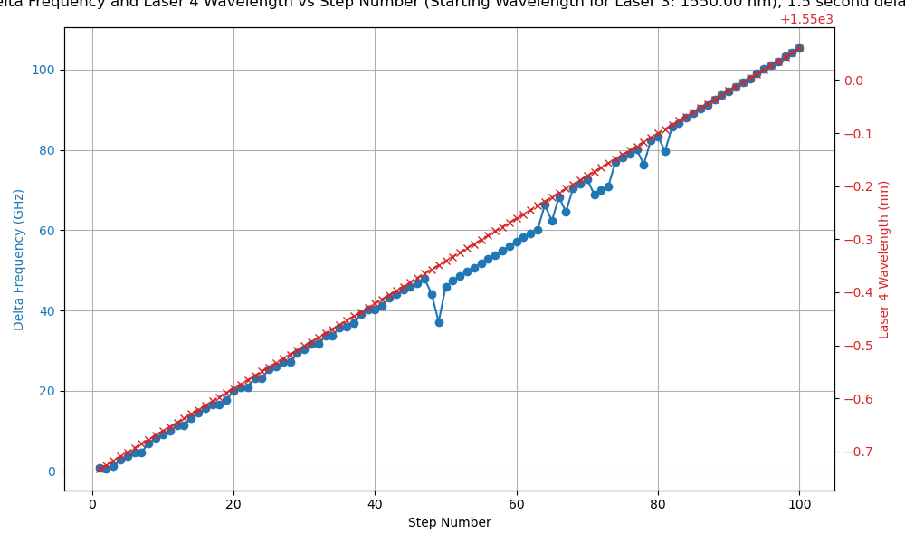
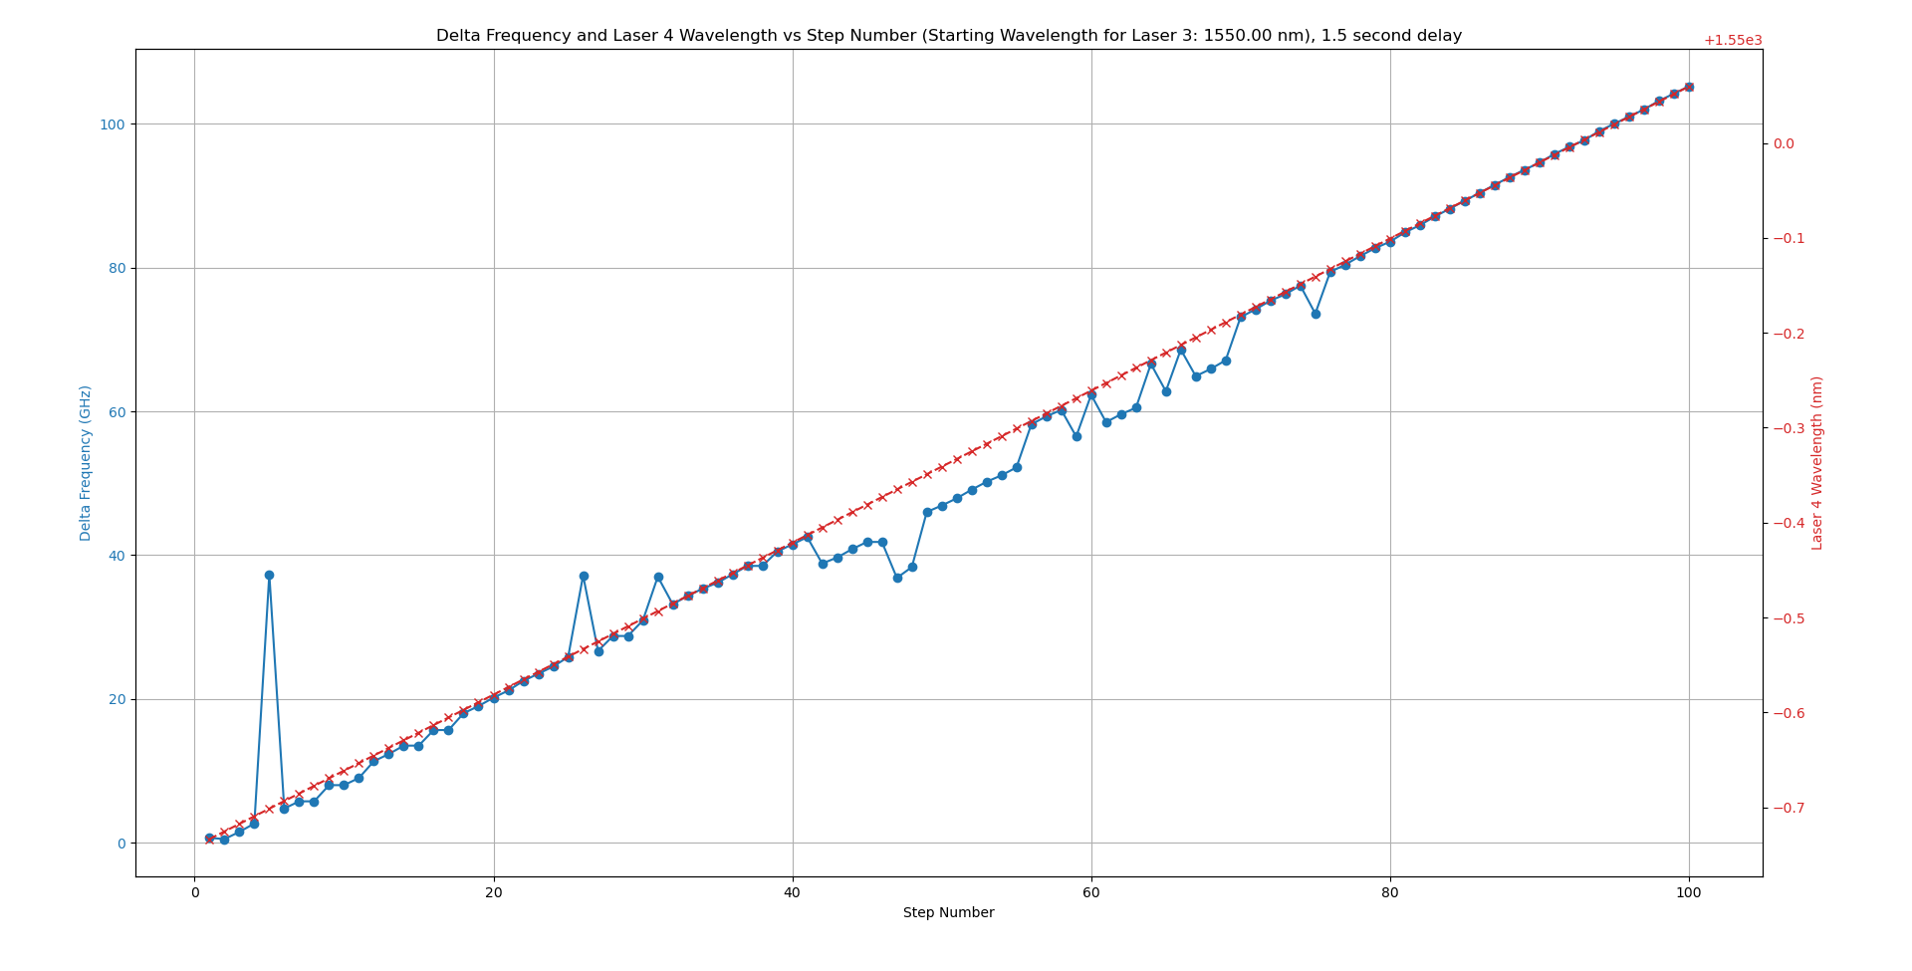
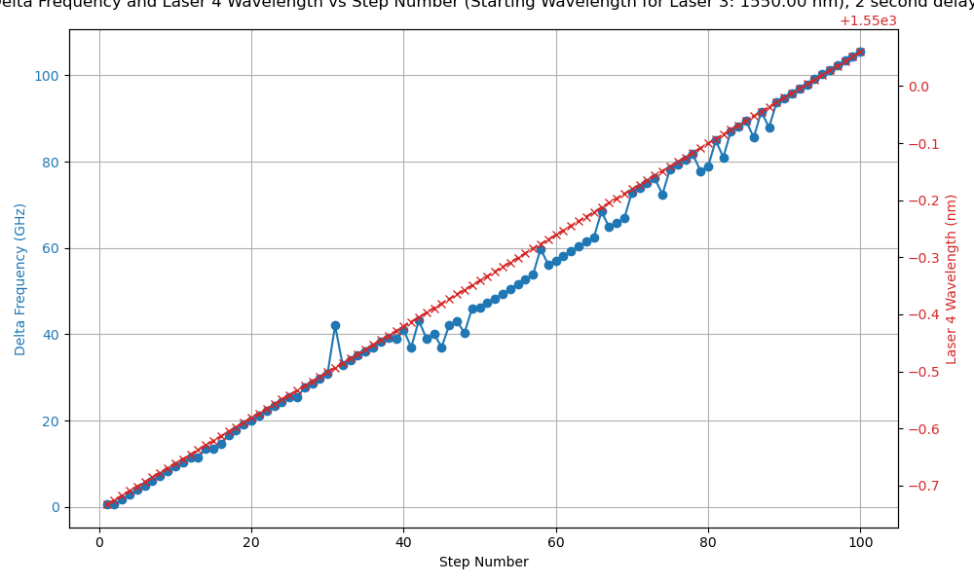
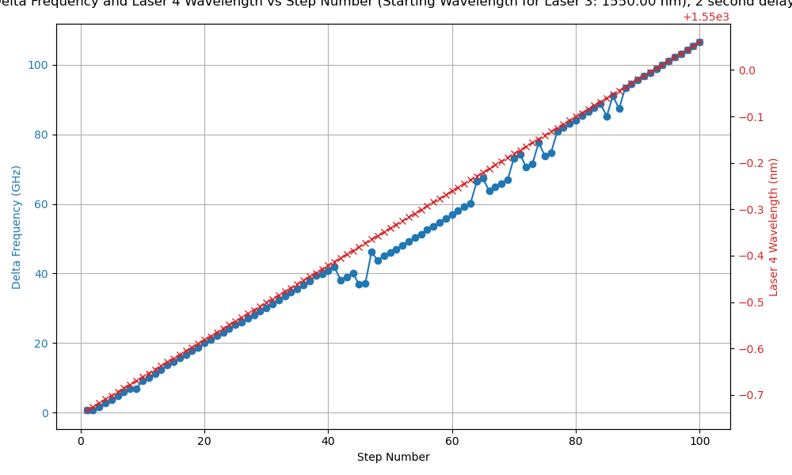
Beat Frequency vs. Step Graphing – 1550 nm
1s Delay
1.5s Delay
2s Delay
Issues common when laser 4 is set between 1549.5-1549.9 nm

Slide 17
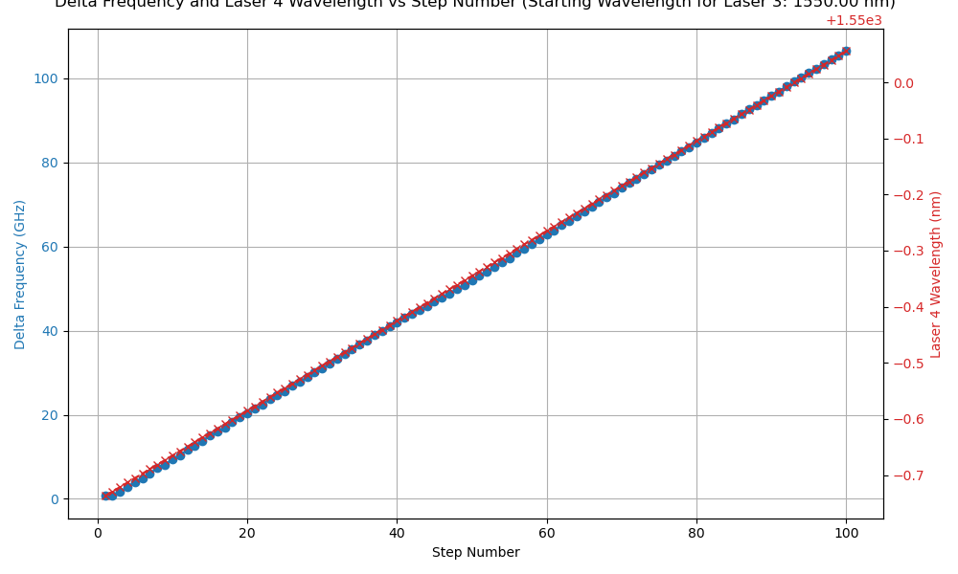
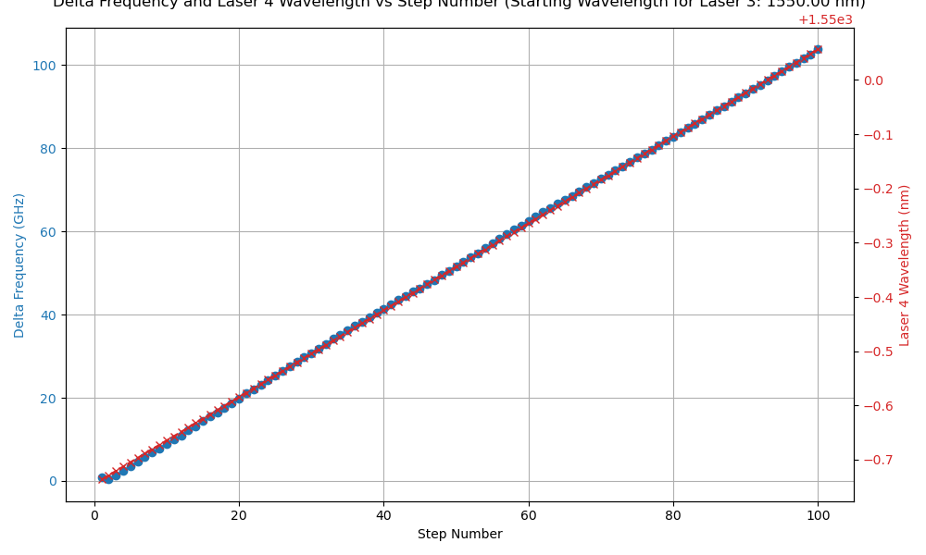
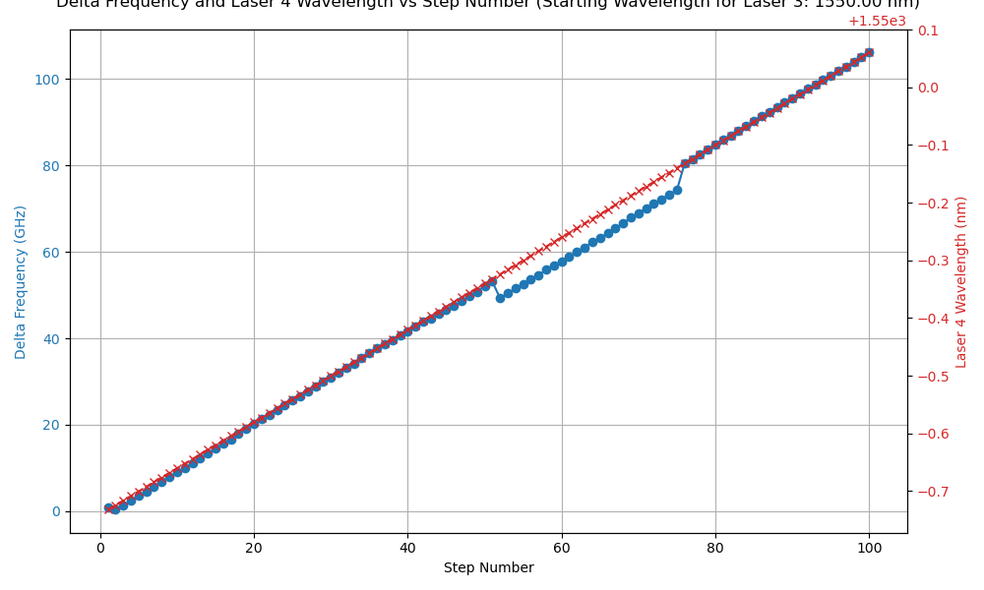
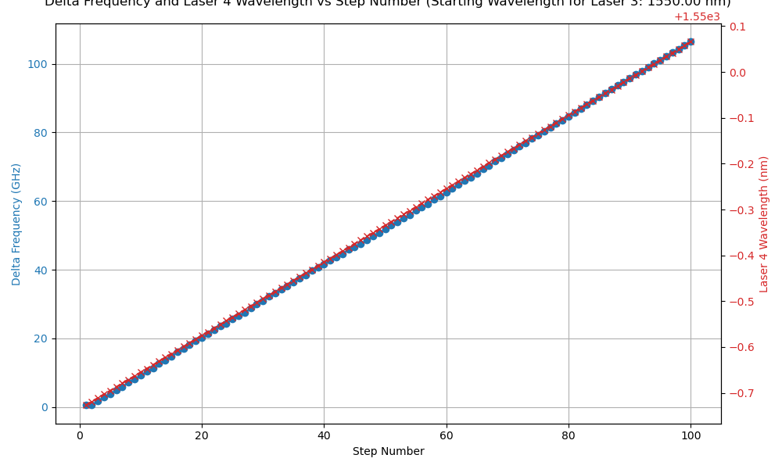

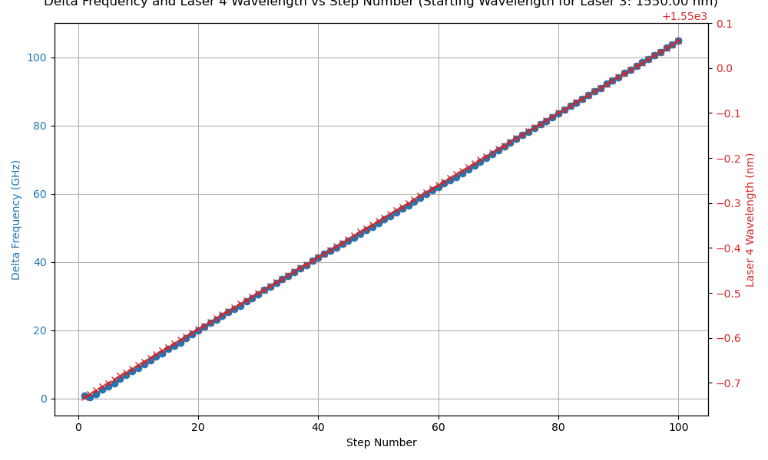
Beat Frequency vs. Step Graphing – 1550 nm
3s Delay
4s Delay
5s Delay
Issues common when laser 4 is set between 1549.5-1549.9 nm

Slide 18
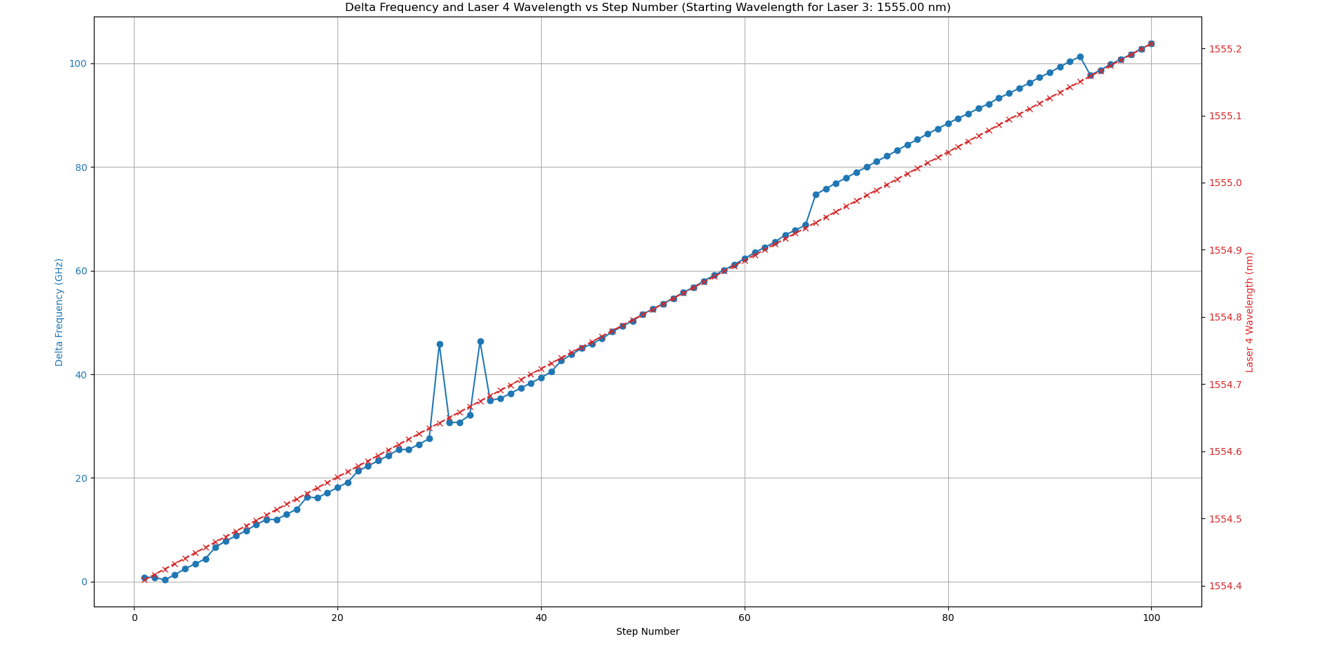
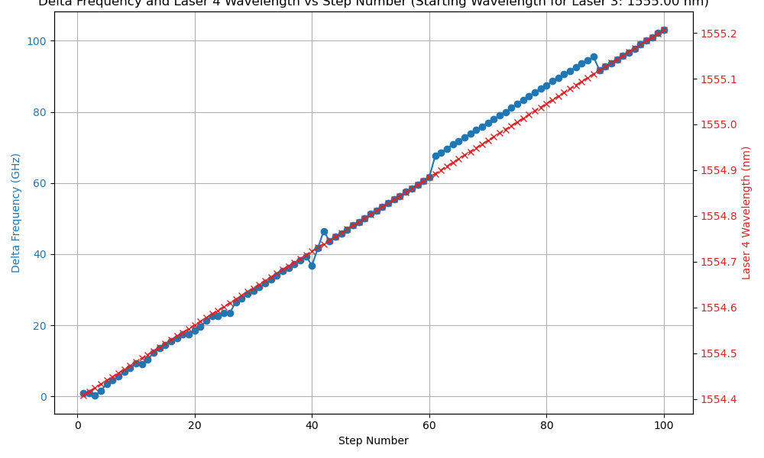
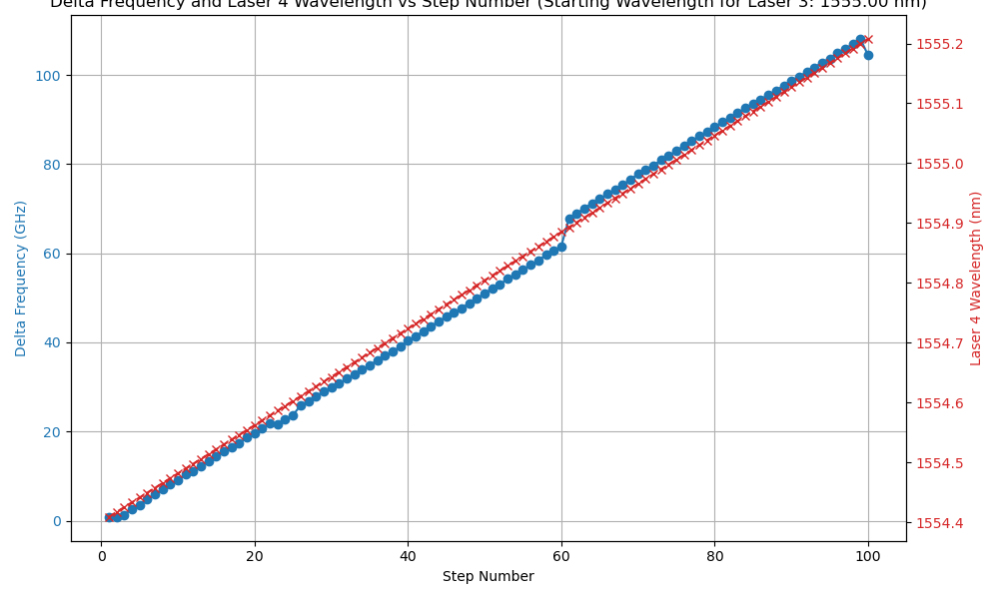
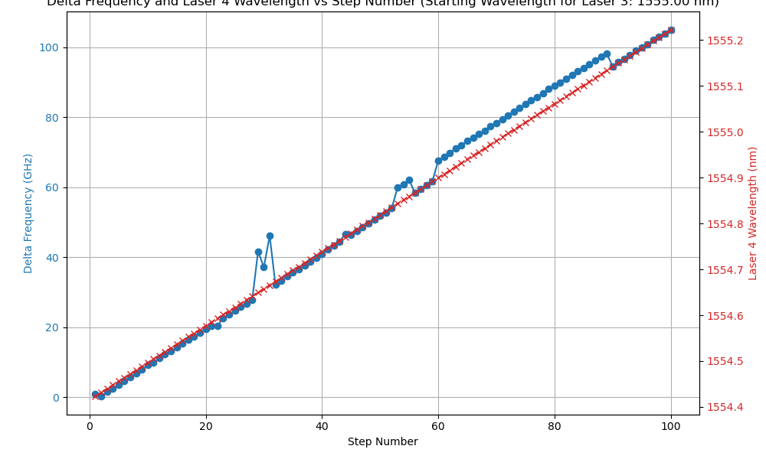

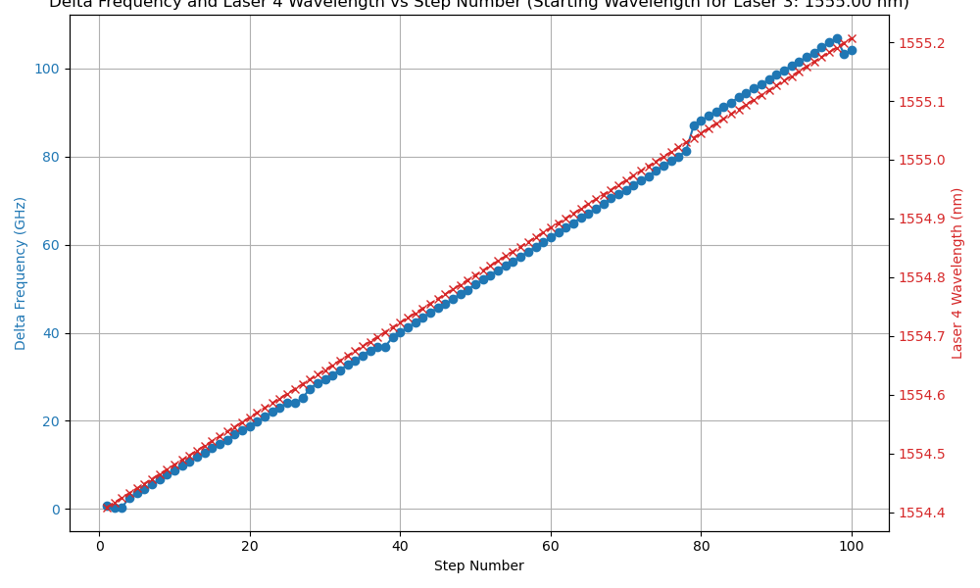
Beat Frequency vs. Step Graphing – 1555 nm
1s Delay
2s Delay
3s Delay
Issues common when laser 4 is set between 1554.9-1555.2 nm

Slide 19
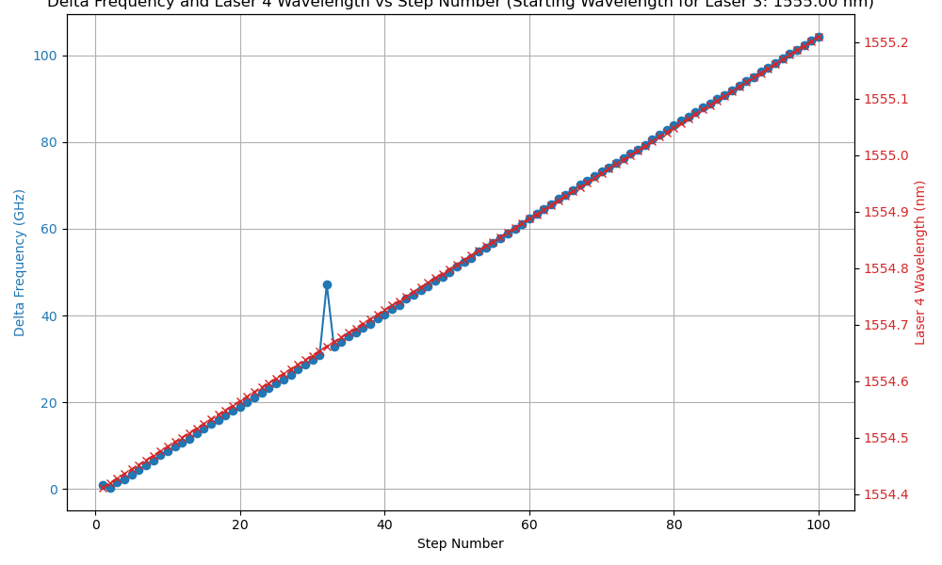
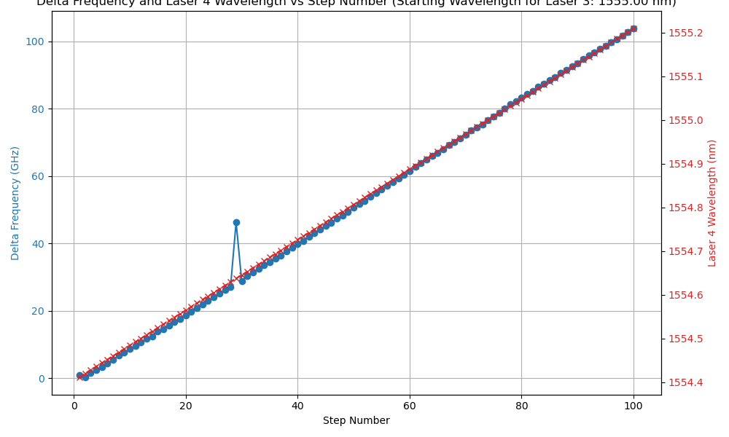
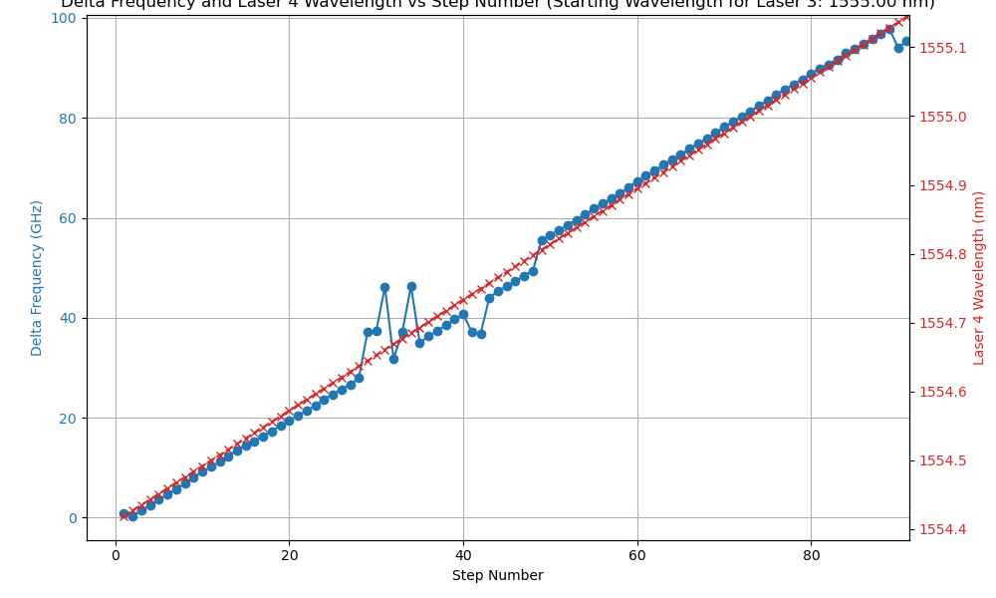

Beat Frequency vs. Step Graphing – 1555 nm
4s Delay
5s Delay

Slide 20
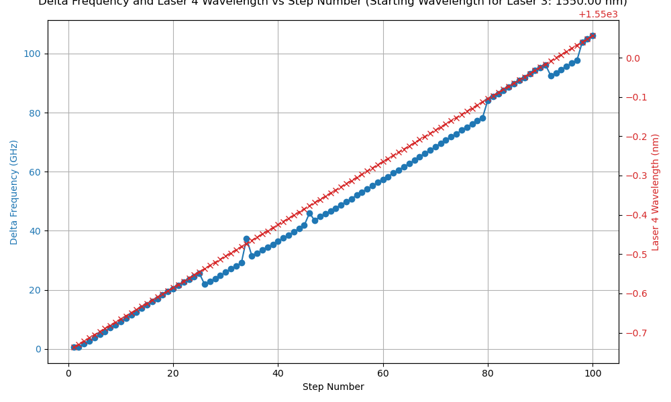
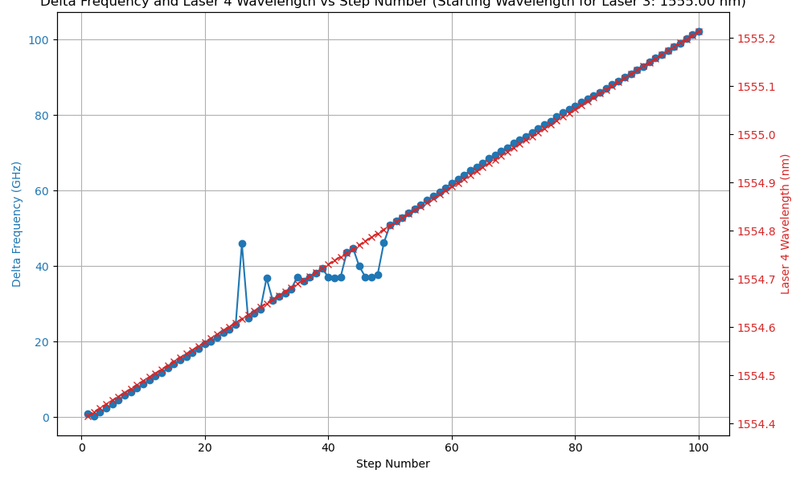
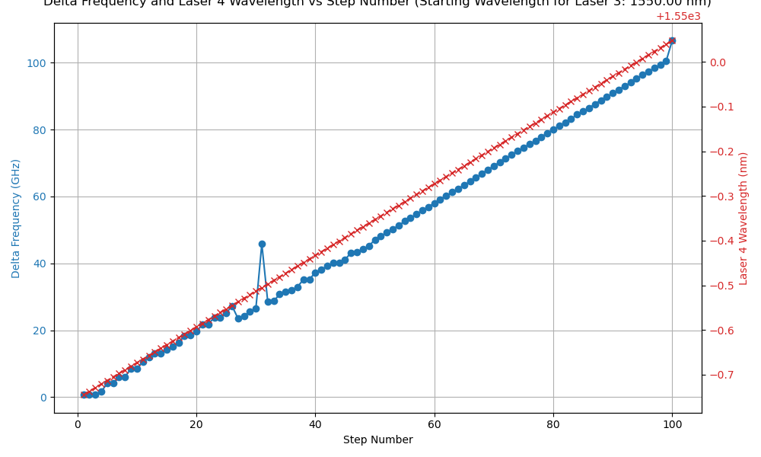
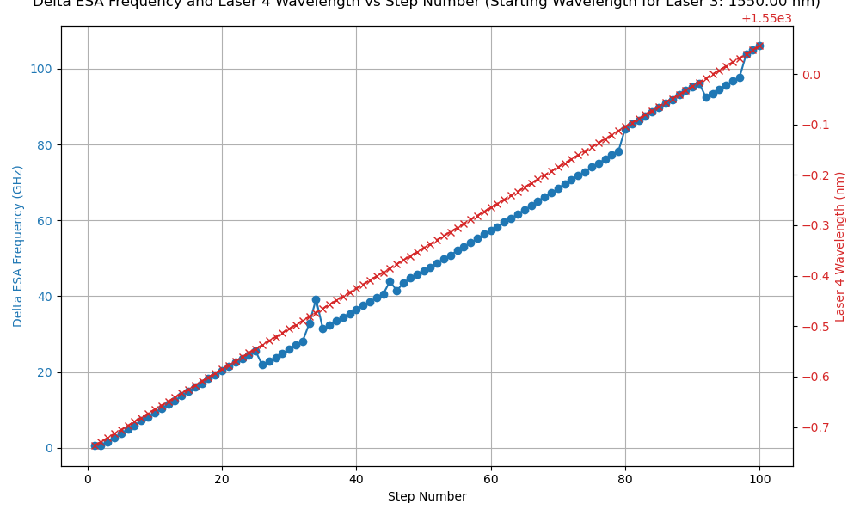
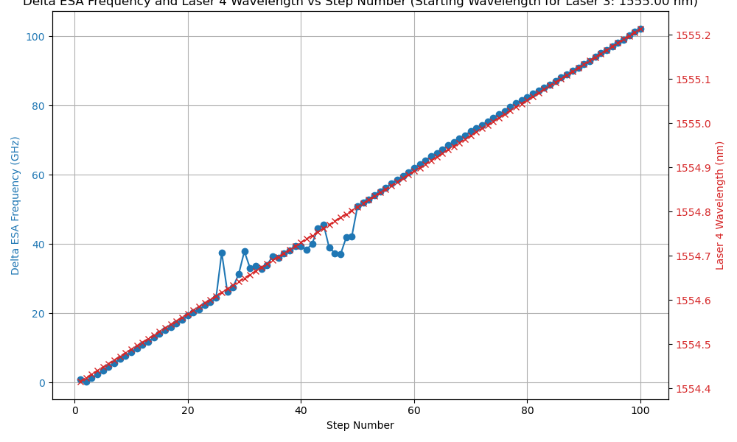
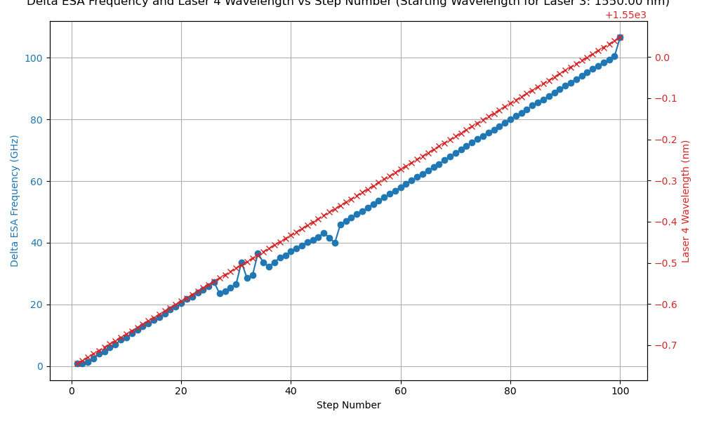
Single Point ESA vs. Averaged
Single Point ESA Measurement
Averaged ESA Measurement

Slide 21
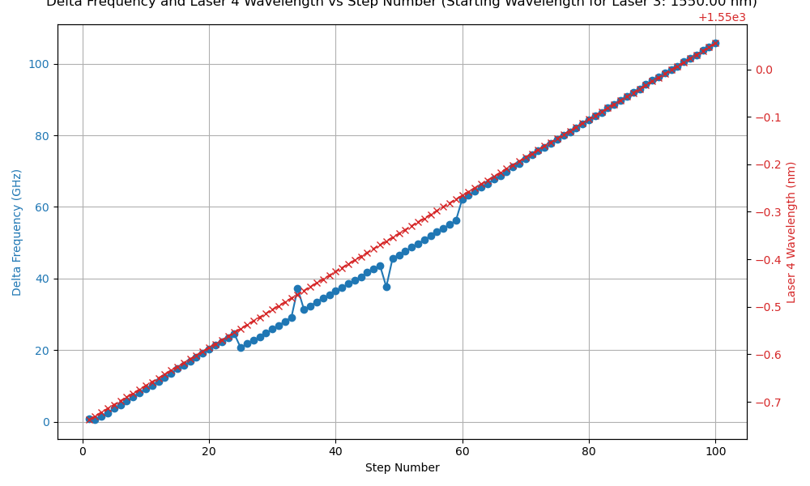
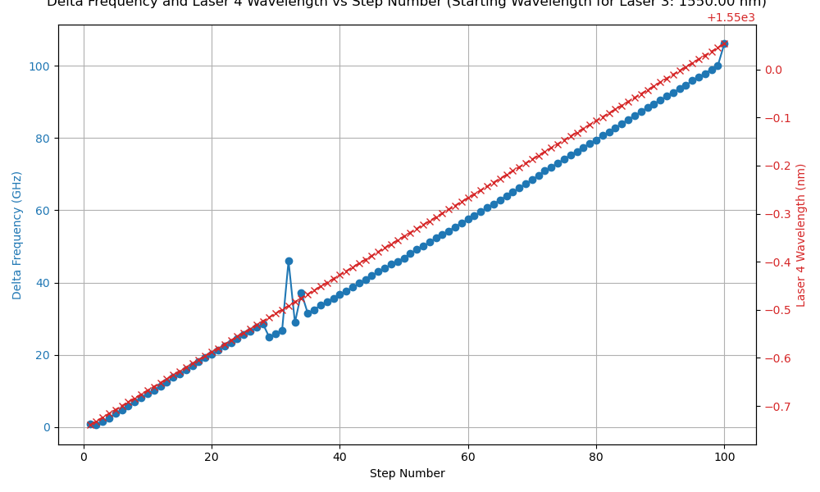
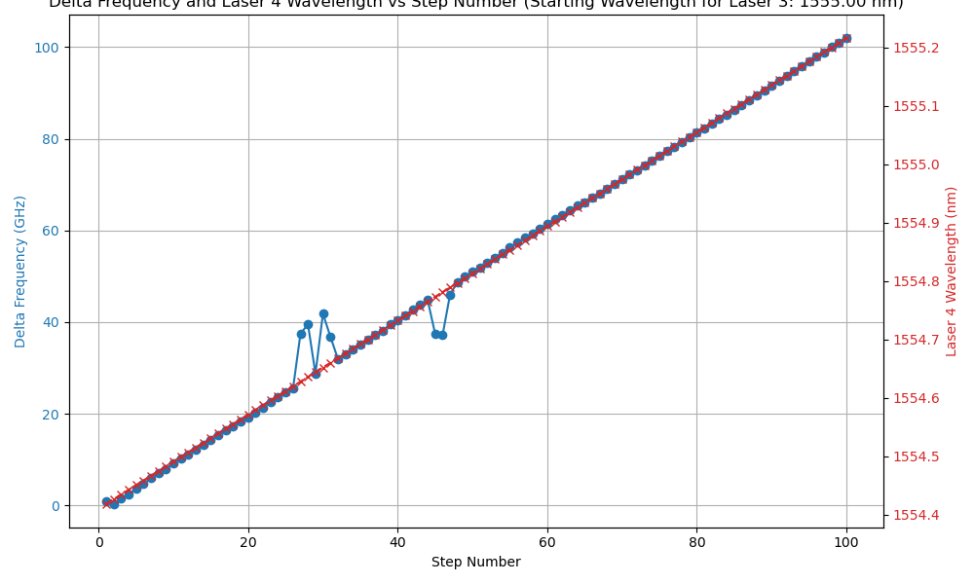

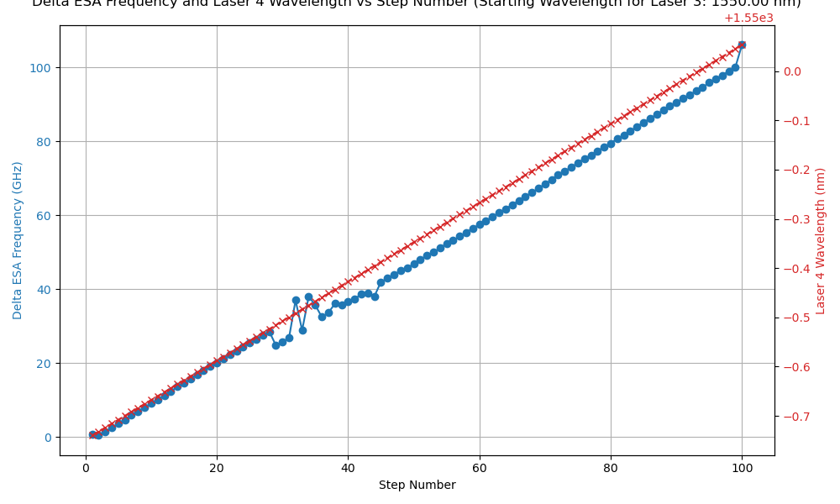

Single Point ESA vs. Averaged
Single Point ESA Measurement
Averaged ESA Measurement

Slide 22
Single Point ESA vs. Averaged
ESA readings are automatically averaged from the instrument
Little difference was found adding additional averaging from multiple query points for the ESA reading compared to single point reading.

